Slide 1


Slide 2
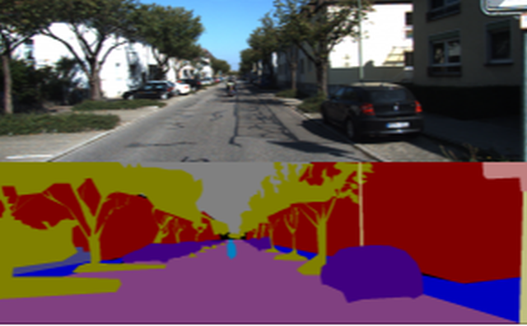
IMAGE SEGMENTATION
Image segmentation is the task of partitioning
image into multiple segments.
Segmentation can be divided into two types
Semantic Segmentation
Instance Segmentation

Slide 3
Semantic Segmentation
Semantic segmentation is the task of assigning a class
to every pixel in a given image.
Instance Segmentation
Different instances of the same class are segmented individually

Slide 4

Algorithm for Image Segmentation
There are many algorithms for solving this image segmentation
such as such as the Watershed algorithm, Image thresholding ,
K-means clustering, Graph partitioning methods, etc.
Many deep learning architectures have also been proposed, but
Google’s DeepLab model has given the best results till date.

Slide 5
Understanding Google’s Deeplab
DeepLab is designed and open-sourced by Google back in 2016.
Multiple improvements have been made to the model since then,
including DeepLab V2 ,DeepLab V3 and the latest DeepLab V3+.
DeepLab model has two steps
Encoding phase : The aim of this phase is to extract essential
information from the image. This is done using a pre trained
CNN
Decoding phase : The information extracted in encoding phase
is used here to reconstruct output of appropriate dimensions

Slide 6
The DeepLab architecture is based on combining two popular
neural network architectures:
Spatial Pyramid Pooling : We need to make sure our model is robust
to changes in the size of objects when working with CNNs.
Spatial Pyramid Pooling use multiple scaled versions of the input
for training and hence capture multi-scale information.
Hence they are able to encode multi-scale contextual information.
Encoder-Decoder networks : Not everything present in the input
will be useful for our model. We would want to extract only the
crucial features that can be used to represent most of the information. They learn to transform the input into a dense form that can be used to represent all the input information.

Slide 7
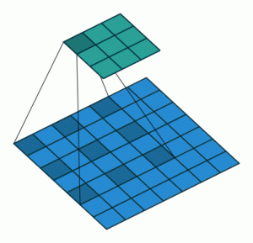
Atrous Convolution
Spatial pyramid pooling uses multiple instances of the same architecture. This leads to an increase in the computational complexity
To Solve this DeepLab has the concept of atrous convolution Atrous convolutions require a parameter called rate which is used to explicitly control the effective field of view of the convolution.

Slide 8
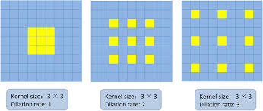
ASPP uses 4 parallel operations, i.e. 1 x 1 convolution and 3 x 3 atrous convolution with rates [6, 12, 18]. It also adds image level features with Global Average Pooling.
Bilinear upsampling is used to scale the features to the correct dimensions.

Slide 9
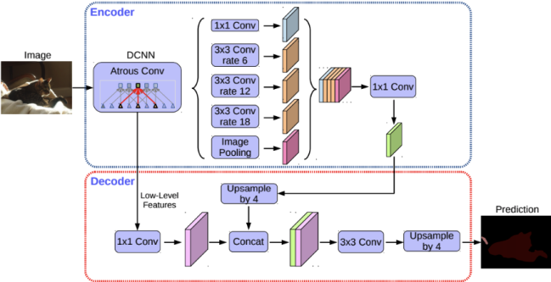
Understanding DeepLab Model Architecture
DeepLab V3 uses ImageNet’s pretrained Resnet-101 with atrous convolutions as its main feature extractor and also uses Atrous Spatial Pyramid Pooling and bilinear upsampling for the decoder module

Slide 10
All max pooling operations are replaced by depth-wise separable convolution with striding
Extra batch normalisation and ReLU activation are added after each 3 x 3 depth-wise convolution
Depth of the model is increased without changing the entry flow network structure
Decoder
The encoder is based on an output stride (ratio of the original image size to the size of the final encoded features) of 16. Instead of using bilinear up-sampling with a factor of 16, the encoded features are first up-sampled with a factor of 4 and concatenated with corresponding low level features from the encoder module having the same spatial dimensions.

Slide 11
Thank You

